Slide 1

Session 2

Slide 2
VPC Basics

Slide 3
What Is a VPC?

Slide 4
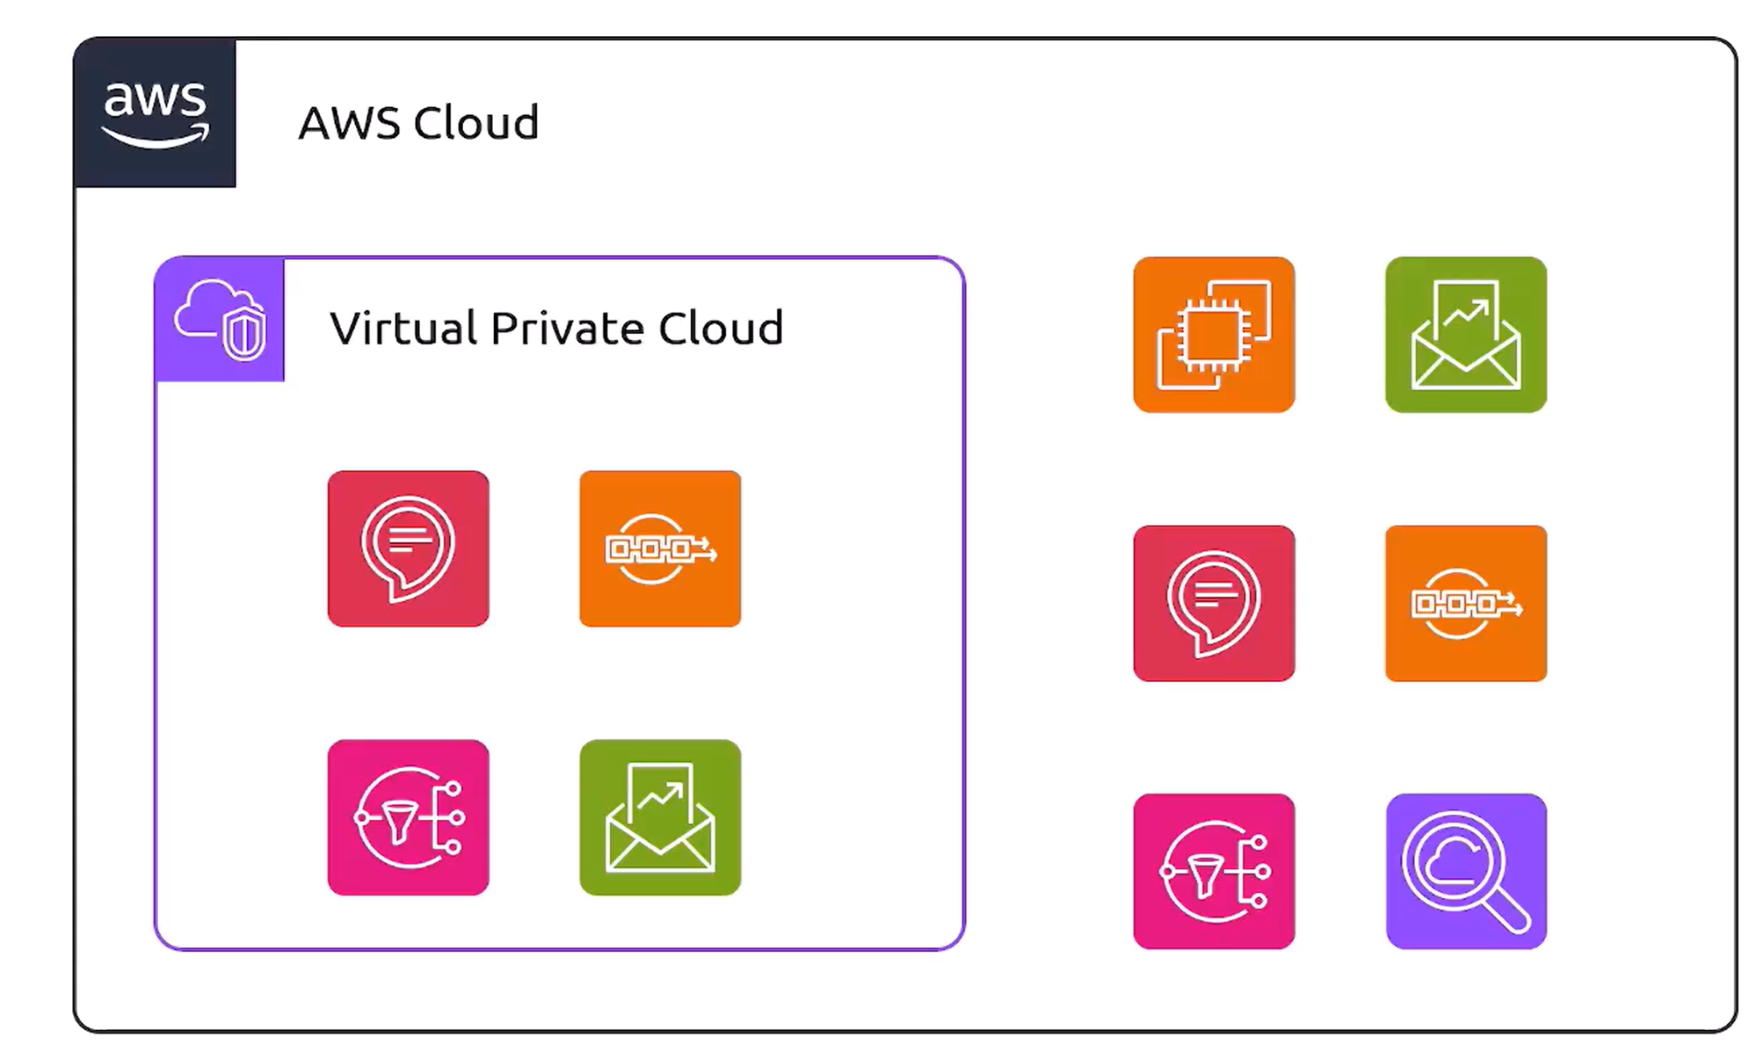
What Is a VPC?

Slide 5
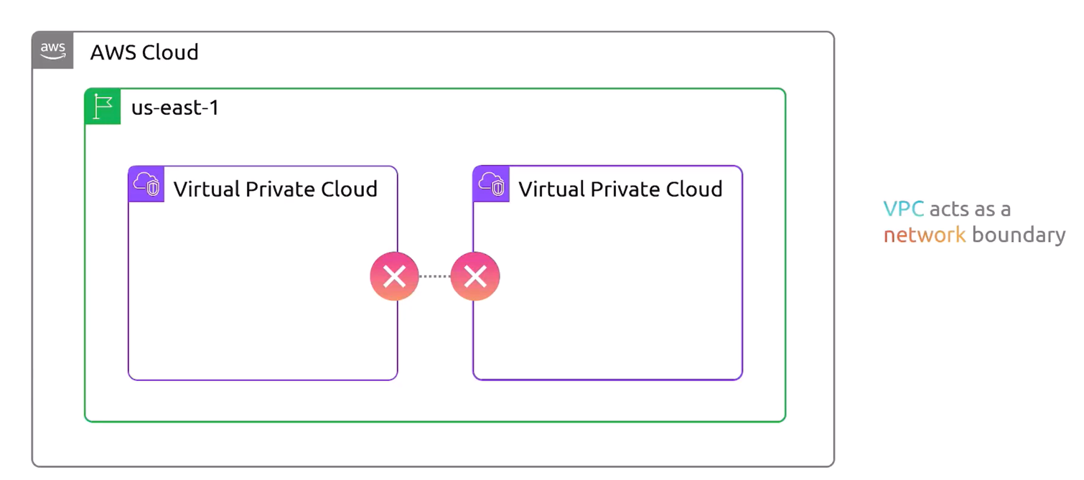
VPC

Slide 6
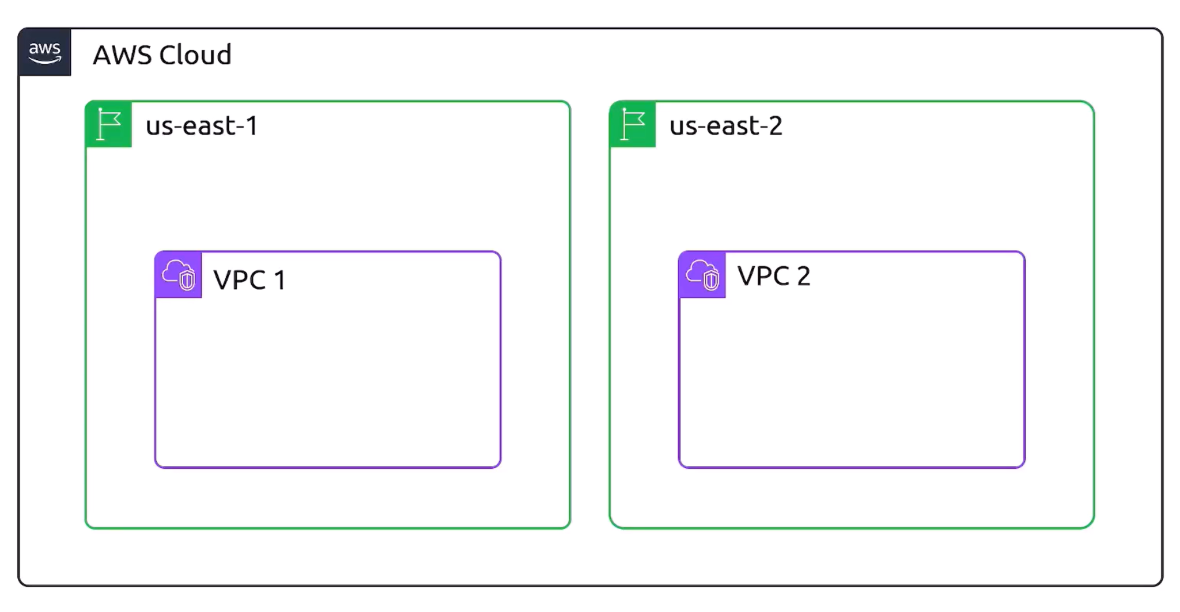
VPCs and Regions
A VPC is specific to a single region

Slide 7
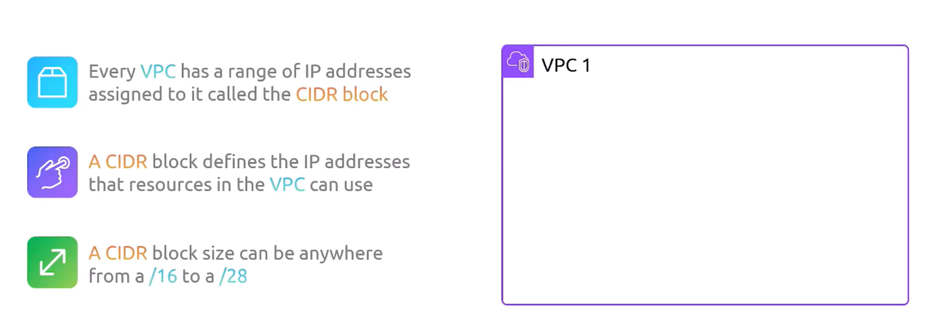
VPC
CIDR: Classless Inter-Domain Routing
10.0.0.0/16

Slide 8
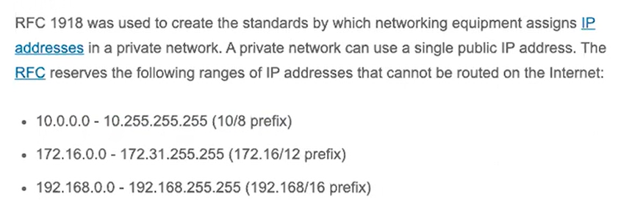
VPC
CIDR: Classless Inter-Domain Routing

Slide 9
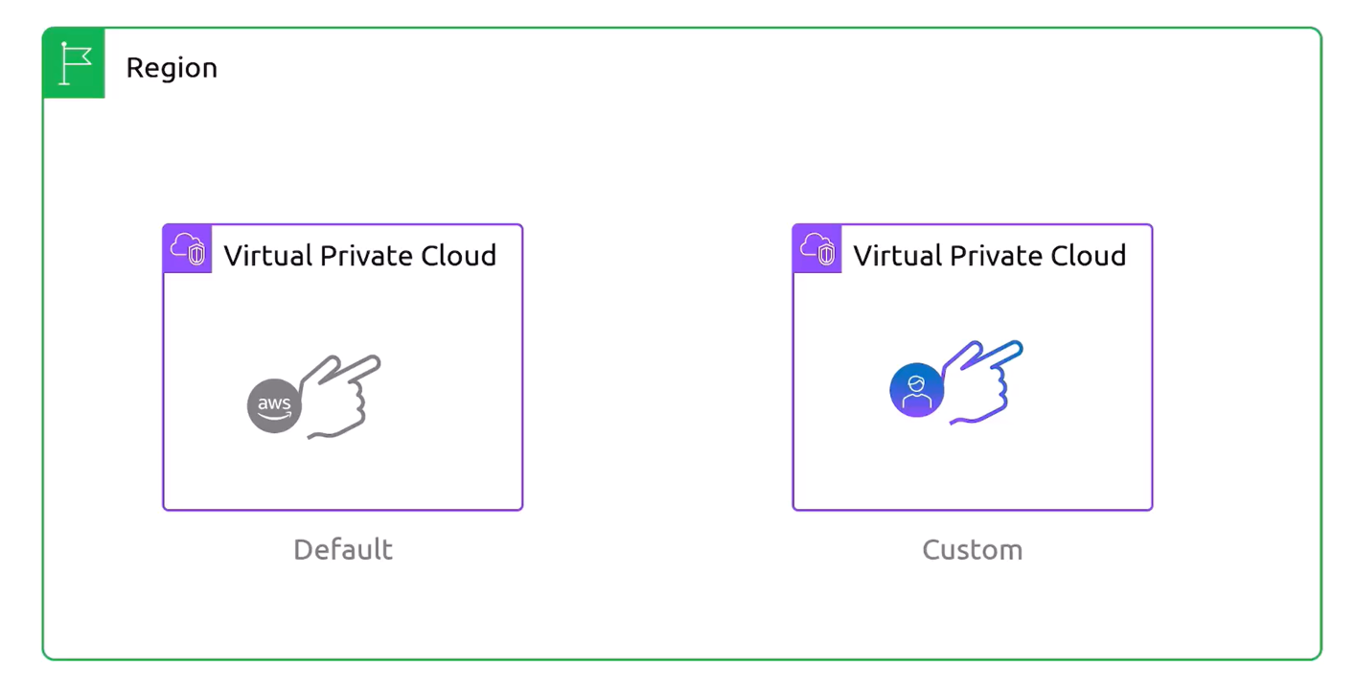
VPC

Slide 10
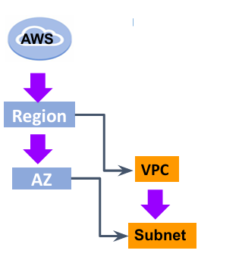
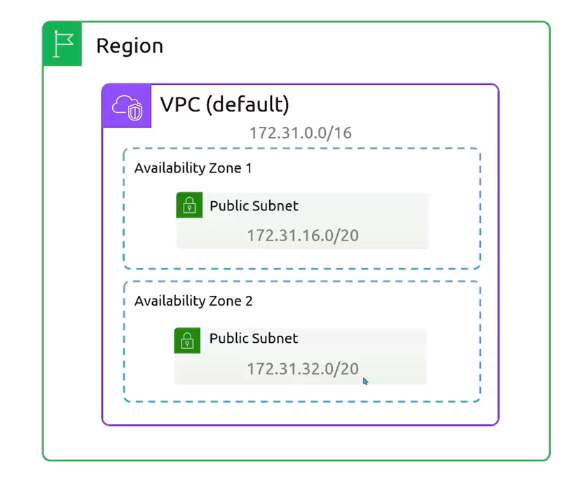
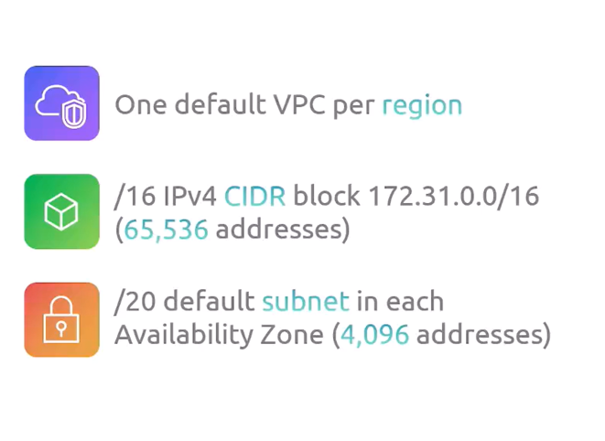
Subnet

Slide 11
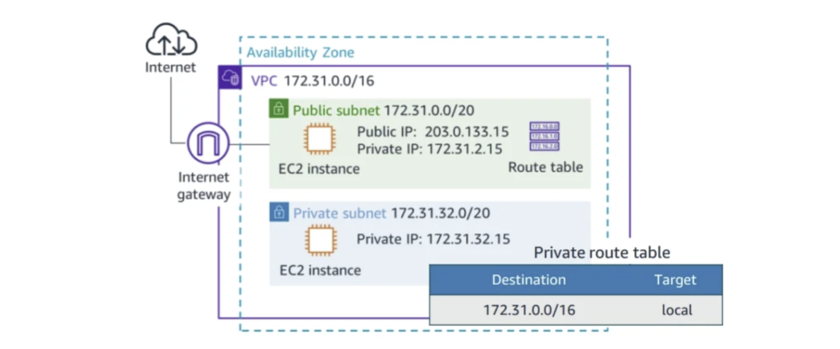
Public/Private Subnet

Slide 12
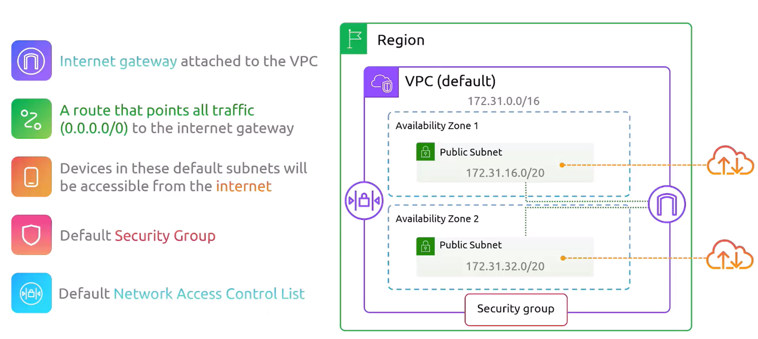
Default VPC

Slide 13
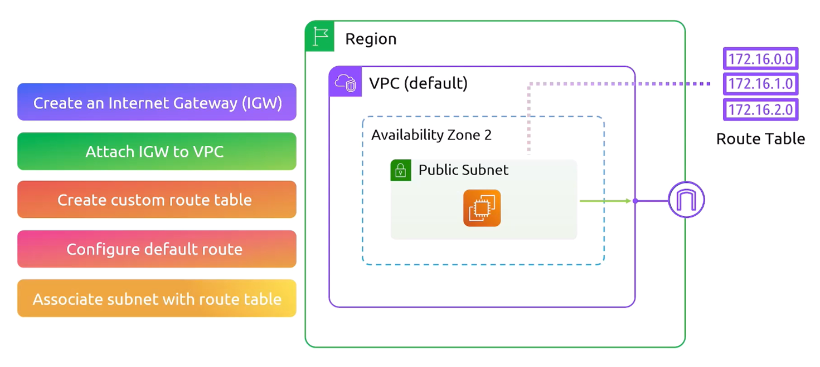
Internet Gateway

Slide 14
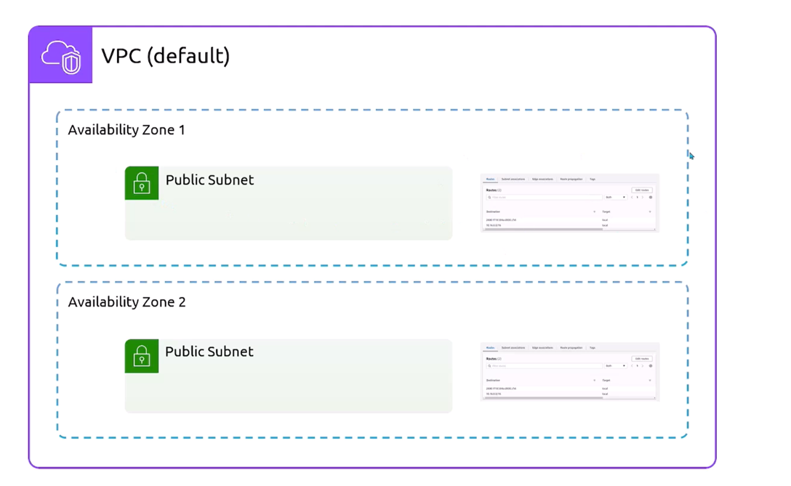
Route Tables

Slide 15
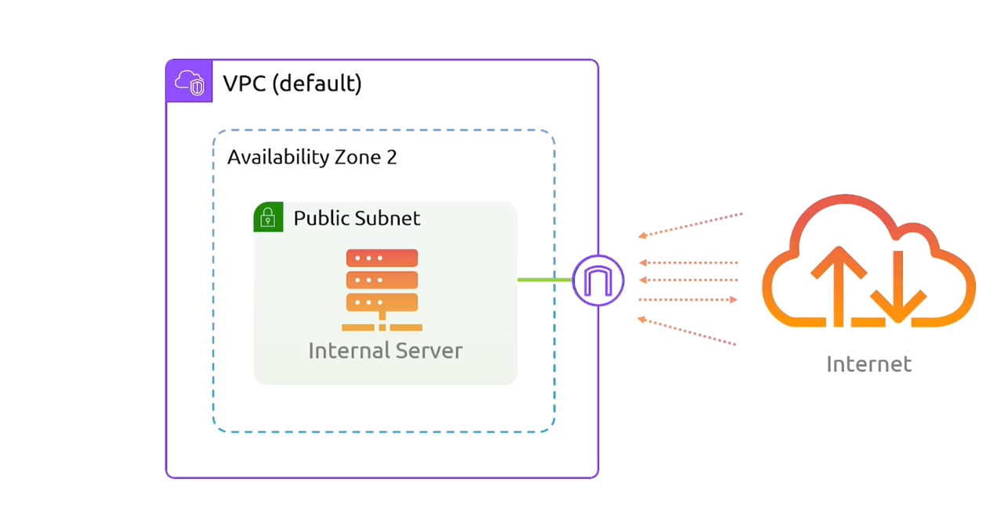
NAT Gateway

Slide 16
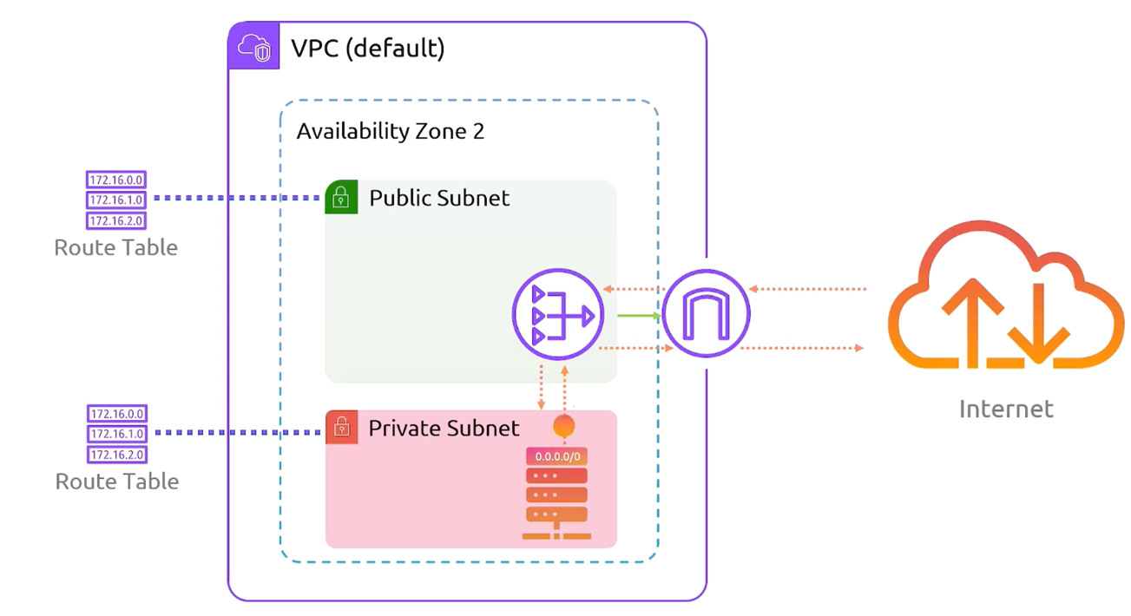
NAT Gateway

Slide 17
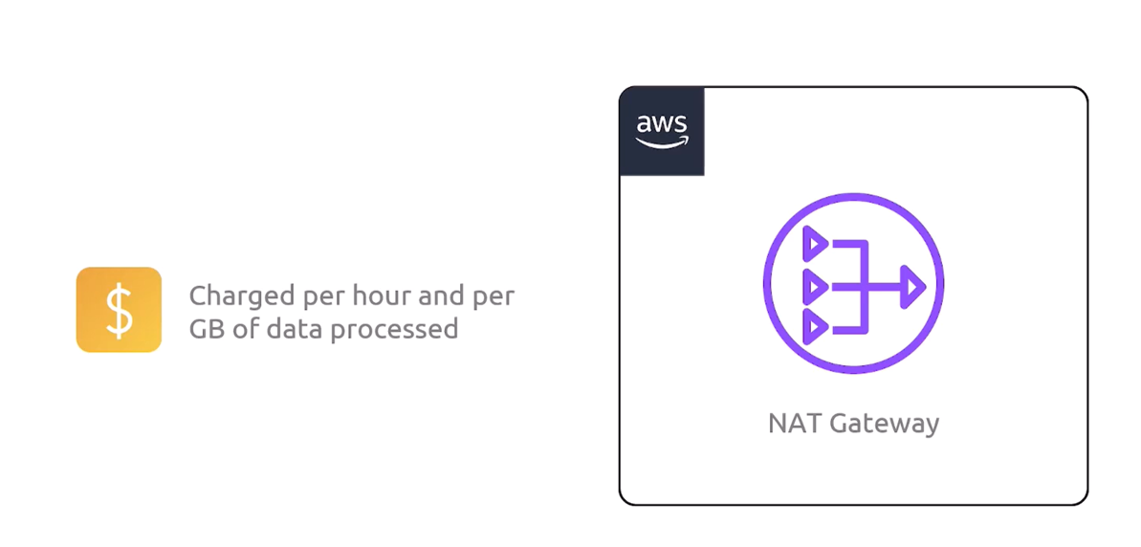
NAT Gateway

Slide 18
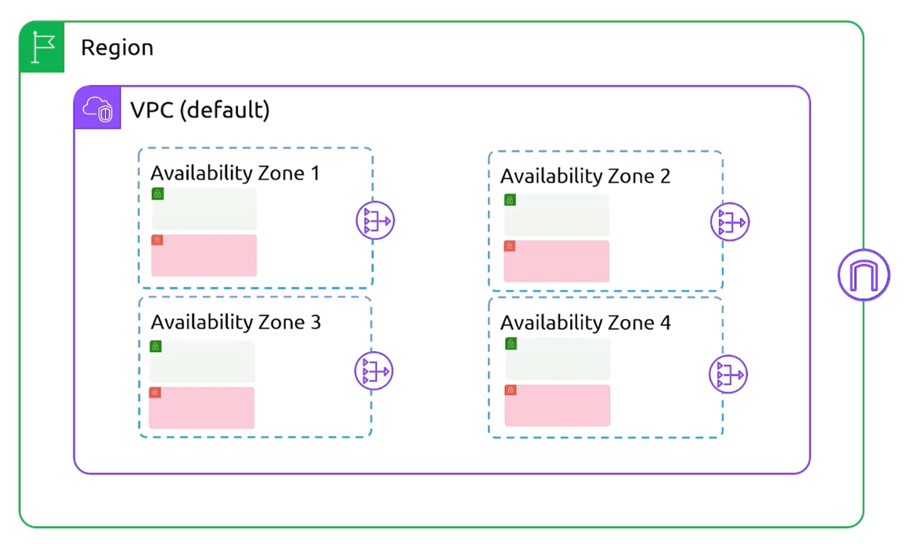
NAT Gateway

Slide 19
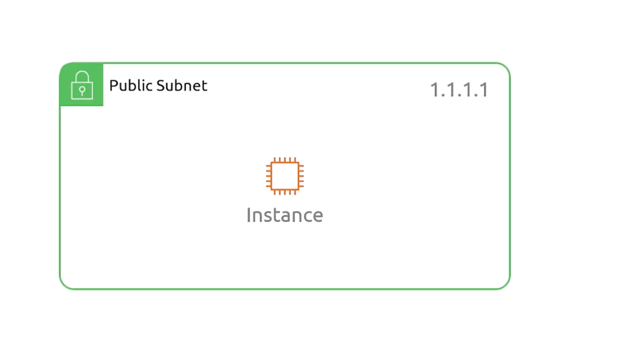
Elastic IPs

Slide 20
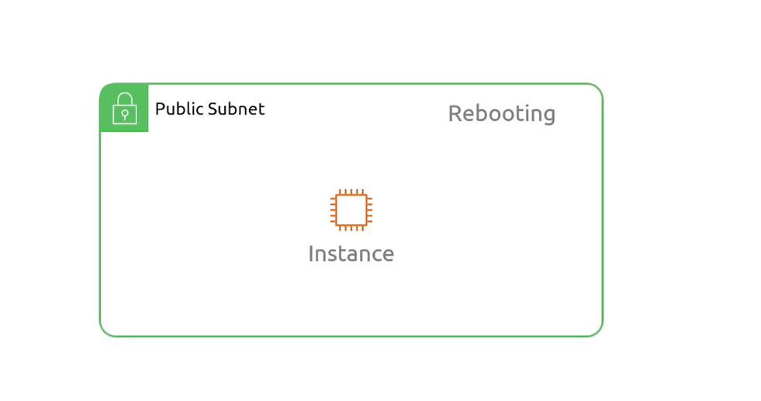
Elastic IPs

Slide 21
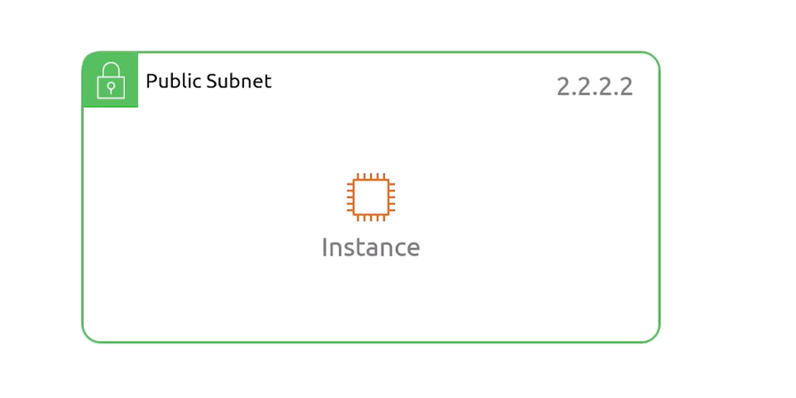
Elastic IPs

Slide 22
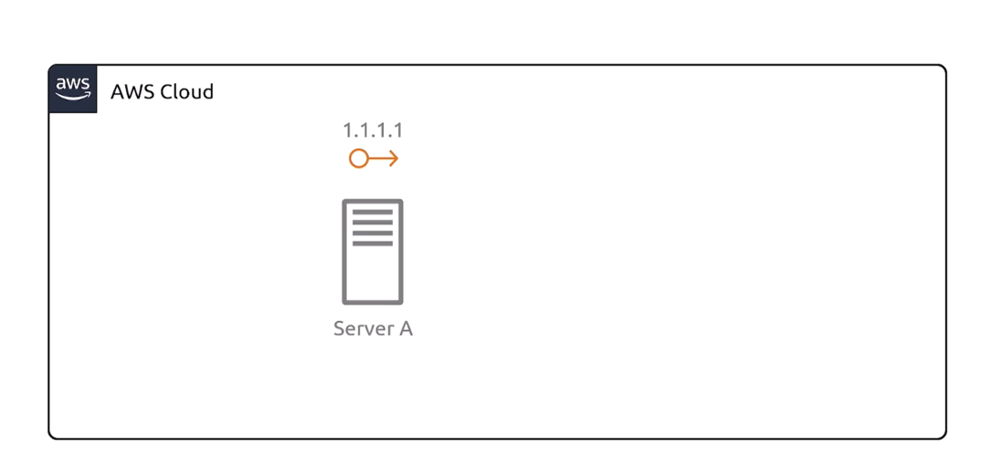
Elastic IPs

Slide 23
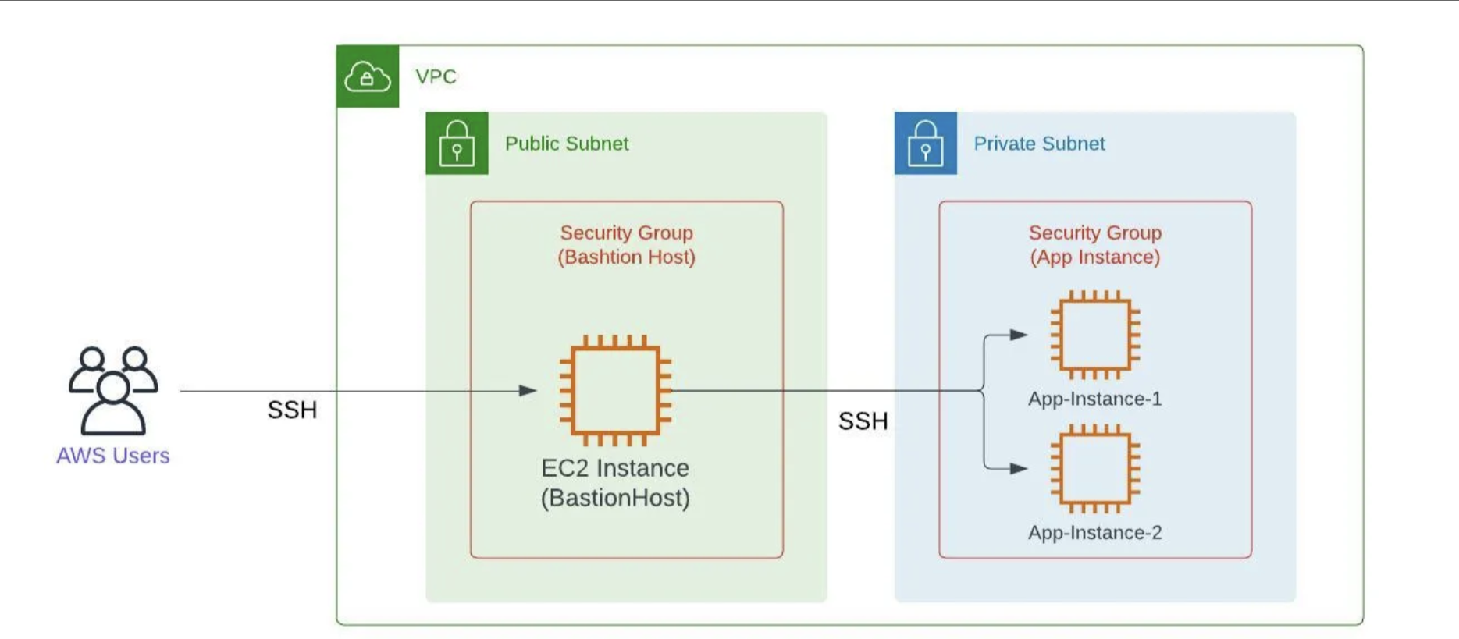
Bastion Host

Slide 24
THANKS FOR LISTENING

